Slide 1
CT216: Introduction to Communication Systems
Yash Vasavada
Professor
DA-IICT
Shannon Channel Capacity Equation and Its Design Implications
15 January 2024

Slide 2
Contents
Spectral and Energy Efficiency of a Wireless Communication System
Wireless System Link Analysis
Multiple Access and Frequency Reuse

Slide 3
Three Critical System Parameters
Following are three critical parameters of any wireless communication system (in fact, any communication system)
Data Rate: Need is to maximize the data rate that can be delivered over the Wireless Communications system
Power
Bandwidth
Data rate achieved is a function of power and bandwidth. We look at this relationship next
Achieved data rate increases with power and it increases with bandwidth. In reality, both these resources are limited

Slide 4
Power and Bandwidth Tradeoff
System designer’s objective: achieve the highest data rate possible
System constraints: limited available power and limited available bandwidth
Maximum possible data rate $R_{b}$ that can be achieved given the power and bandwidth constraint is bounded by the following well-known equation by Claude Shannon that sets the channel capacity $C$
Assumes that the only impairment introduced by the transmission channel is the Additive White Gaussian-distributed Noise.
Such a channel is accordingly called the AWGN channel, and the following formula is known as the capacity of the AWGN channel
$$R_{b}≤C=B×\log_{2}\left(1+\frac{P_{S}}{P_{N}}\right)$$
bits per second

Slide 5
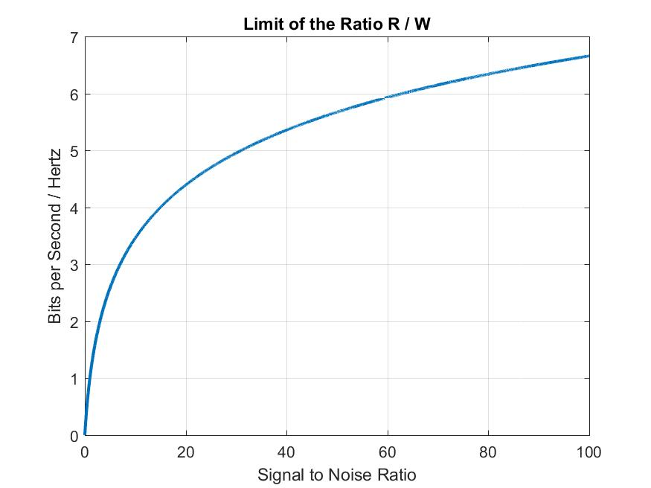


Spectral Efficiency
Spectral efficiency is a key metric that denotes whether the available bandwidth is utilized efficiently for data transport
Defined as the ratio of bit rate to bandwidth: $\frac{R_{b}}{B}≤\frac{C}{B}=\log_{2}\left(1+\frac{P_{S}}{P_{N}}\right)$ in bps/Hz
Higher value → many bits are getting transported for each Hertz of bandwidth
Possible when a lot of power is available
Low value → only a few bits are transported for each Hz of bandwidth
Possible when a lot of bandwidth is available
Ratio $C/B$

Slide 6
Several Spectral Scenarios
Four examples of wireless system spectral occupancies
FR1 (Frequency Range 1, below 6 GHz)
System 1: low bandwidth, can support low data rates
System 2: medium bandwidth, can support medium data rates
FR2 (Frequency Range 2, mmWave, above 6 GHz)
System 3: high bandwidth, can support high data rates
System 4: high bandwidth, can support high data rates
Frequency
FR1: 2.5 GHz
FR2: Above 6 GHz

Slide 7
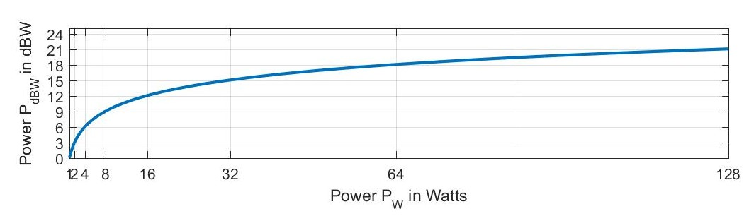

Amplitude, Power, and Energy
Power is given as $P=V×I=\frac{V^{2}}{R},$ i.e., $P∝V^{2}$. Units are in Watts.
Power is typically represented in logarithmic decibel unit. Convention: $P_{dBW}=10×\log_{10}{P_{W}}$ in dBW.
Decibel unit converts an exponential growth into a linear growth
For each doubling of (or halving of) power $P_{W}$, the power $P_{dBW}$ increases (or reduces) by 3 dB

Slide 8

An Aside: Logarithmic versus Linear Units
Substantial amount of increase in Watts translates to only a small increase in dBW
Power in dBW of 30 dBW or 40 dBW is a lot of power in Watts (1000 W or 10000 Watts)
Multiplication of power numbers in Watts is same as addition in dBW
Division is same as subtraction
Ratio of power $P_{W}^{1}/P_{W}^{2}$ in Watts has no unit; likewise difference of $P_{dBW}^{1}−P_{dBW}^{2}$ is in dB and not in dBW
For each 10 times increase/decrease of $P_{W}$, power $P_{dBW}$ increases/decreases by 10 dB

Slide 9

An Aside: Logarithmic versus Linear Units
Amplifier gain $G$ is often specified as a power ratio in dB
$$G_{dB}=10×\log_{10}{\frac{P_{Out}}{P_{In}}}=10×\log_{10}{\frac{V_{Out}^{2}}{V_{In}^{2}}}=20×\log_{10}{\frac{V_{Out}^{}}{V_{In}^{}}}$$
Therefore,
$P_{Out}=P_{in}×{10}^{0.1G_{dB}}$, and $V_{Out}=V_{in}×{10}^{0.05G_{dB}}$
Power in dBm is $P_{dBm}=10×\log_{10}{P_{mW}}$, where $P_{mW}={10}^{3}P_{W}$ is power in milliwatts
$P_{dBm}=30+P_{dBW}$
Other decibel units that are often used in Communications Engineering are dBi, dBc and dBFS

Slide 10
Amplitude, Power and Energy
Transmitter objective: use as little power as possible.
Receiver’s wish: transmitter uses as high a power as feasible
In general, communication system design is constrained by the power
There is never an infinite power
Reduction in the power requirement is always of system benefit and of economic value
Maximum power that can be delivered is limited by the amplifier used. More expensive the amplifier, the greater the max power but also greater (often prohibitively) the cost

Slide 11

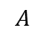
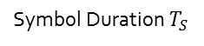
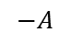
Amplitude, Power, and Energy
Energy $E$ in Joules is power $P$ Watts integrated over time $T$
For the following waveform, energy per symbol: $E_{S}∝A^{2}T_{S}=P×T_{S}=P/R_{S}$
Here, $T_{S}$ is the symbol duration in seconds and $R_{S}$ is the symbol rate in symbols/sec
Amplitude
A Binary Symbol Stream
$$A$$
Time
$$−A$$
Symbol Duration $T_{S}$

Slide 12


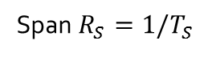
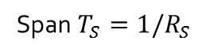
Amplitude, Power and Energy
A rough analogy and a conceptual (mathematically inexact) visualization of the dual relationship between the power and energy in time-frequency domains
Thus, two ways of measuring the quality or fidelity of the received signal compared to the noise
Ratio of power levels of signal and noise (level ratio in time domain, area ratio in frequency domain)
Ratio of energy levels of signal and noise (level ratio in frequency domain, area ratio in time domain)
Time Domain
Frequency Domain
Area: $P×T_{S}=P/R_{S}$ equals the energy $E$ over time period $T_{S}$
Area: $E×R_{S}=E/T_{S}$ equals the power $P$ over bandwidth $R_{S}$
Span $T_{S}=1/R_{S}$
Span $R_{S}=1/T_{S}$

Slide 13

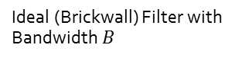
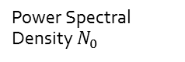
Example: White Noise
The noise affecting the wireless communication link is often modeled as spectrally white
Analogous to the spectrum of the white light, the noise is typically observed to have all the frequency components that are statistically equally powered (i.e., power spectral density or PSD equals a constant $N_{0}$)
At the receiver, the received signal plus the noise is filtered by a filter with bandwidth $B.$ The noise power at the filter output is, therefore, $P_{N}=N_{0}B$
Power Spectral Density $N_{0}$
Ideal (Brickwall) Filter with Bandwidth $B$
Filter Bandwidth B

Slide 14
Block Diagram of Ground Segment
Transmitted power is determined by the HPA used
Attained bandwidth is determined by the design of modem
Allotted bandwidth is determined by the spectrum granted by the regulatory bodies (e.g., FCC, ITU)
Signal to/from SAT
Data rate is as required by the user (e.g., a video download/upload will have a much greater data rate requirement compared to transfer of emails)

Slide 15
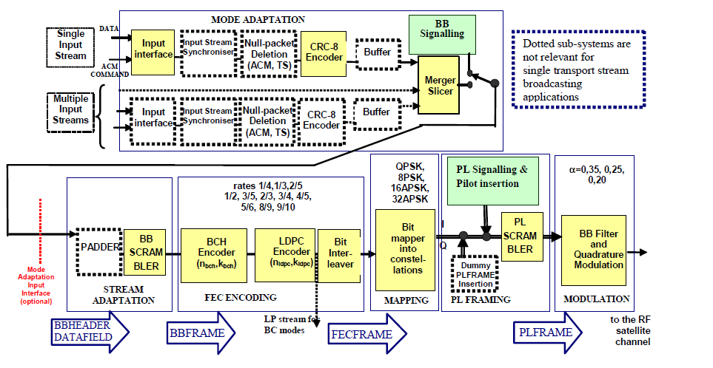
Simplified Versus Actual Transmitter
Simplified:
Bit Rate:
$R_{b}$ bits/sec
Symbol Rate:
$R_{S}$ symbols/sec
Detailed
(for DVB-S2 system):

Slide 16

Symbol Rate and Information (Bit) Rate
How is the symbol rate $R_{s}$ related to the bit rate in a digital (wireless or wireline) communication system? To answer this question, we need to consider the block diagram of the transmitter
Channel Encoder: introduces redundancy in the information bit stream to better protect against the noise encountered in the transmission channel.
Every block of, say, $N$ information bits is transformed to an encoded block of $\frac{N}{r}≥N$ encoded bits, where $r$, $0<r≤1,$ is the coding rate.
Protection against the noise is achieved at the cost of a precious measure. Incoming rate of $R_{b}$ is (artificially) inflated to $R_{b}/r$ bits/sec
A Simplified Diagram of the Transmitter of a Digital Communication System
Bit Rate:
$R_{b}$ bits/sec
Bit Rate:
$R_{b}/r$ bits/sec
Symbol Rate:
$R_{S}=\frac{R_{b}}{rk}$ symbols/sec

Slide 17
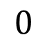

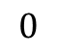
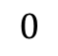



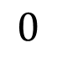
Channel Encoding: Why Is It Needed?
Channel encoding scheme makes the transmitter send more bits than needed
However, extra bits provided parity checks and they help the receiver recover from the errors in the received message
An extremely simple example of channel encoding: can “undo” one bit of error every three bits
$$1$$
$$1$$
$$1$$
$$1$$
$$1$$
$$0$$
$$0$$
$$0$$
$$0$$
$$0$$

Slide 18
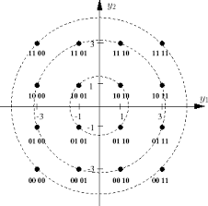
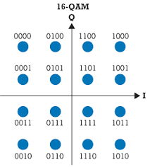
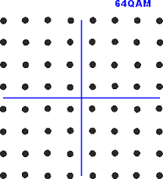
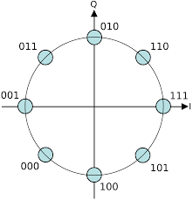
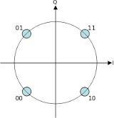
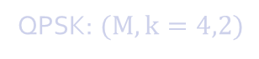
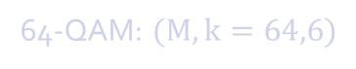

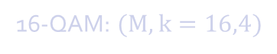
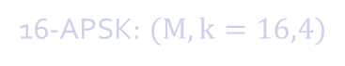
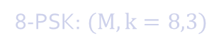
Different Types of Modulation
Bits to Symbol Mapping is performed by the modulator
Modulator converts the real-valued bit stream to (typically) a complex-valued symbol stream
Bits are binary (take only two values); symbols are $M$-ary (take any one of, typically, ${M=2}^{k}$ values)
A serial bit stream is converted to a parallel bit stream where each of the parallel branches comprises of a block of $k$ sequential bits. Each such block is transformed to one of $M$ symbols
QPSK: $(M,k=4,2)$
8-PSK: $(M,k=8,3)$
16-APSK: $(M,k=16,4)$
16-QAM: $(M,k=16,4)$
64-QAM: $(M,k=64,6)$

Slide 19
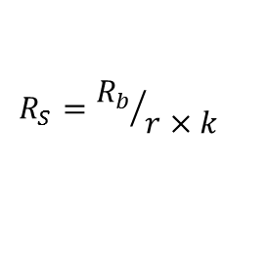
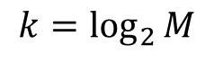
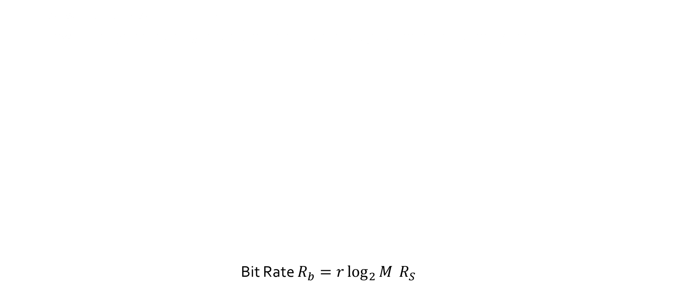
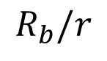
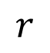
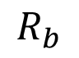
Symbol Rate and Information (Bit) Rate
Now, we can answer the question:
How is the symbol rate $R_{s}$ related to the bit rate in a digital communication system?
Bit Rate $R_{b}=r\log_{2}{M} R_{S}$
$$R_{b}$$
$$r$$
$$R_{b}/r$$
$$k=\log_{2}{M}$$
$$R_{S}={R_{b}}/{r×k}$$

Slide 20
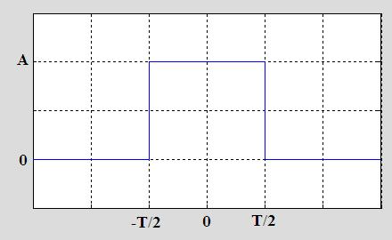
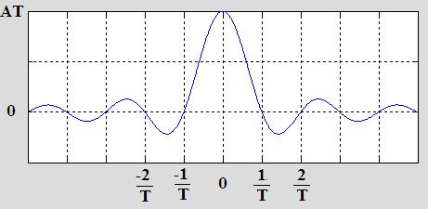
Symbol Rate and Bandwidth
Square wave of width $T$ seconds has a spectrum that spans over $\frac{1}{T}$
Communication systems rarely use square wave. A common practice is Root Raised Cosine (RRC) pulse shape
Time Domain Frequency Domain

Slide 21
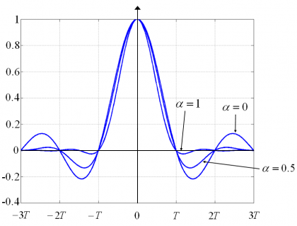
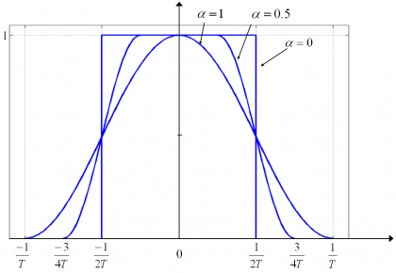
Symbol Rate and Bandwidth
Raised Cosine Filters with Different Roll-off Factors $α$
If $α=0,$ it is seen that a symbol rate of $T_{S}$ translates to a bandwidth of $B=\frac{1}{T_{S}}=R_{S}$
In general, the rule of thumb, for arbitrary $α$ is as follows: $B=R_{S}×(1+α)$
Time Domain Frequency Domain

Slide 22
Signal to Noise Ratio and Bit Error Rate
Performance of communication system is determined by the ratio of the (carrier or) signal power $P_{S}=C$ to the noise power $P_{N}=C$ at the receiver. This is called SNR or C/N.
SNR $=\frac{C}{N}=\frac{P_{S}}{P_{N}}$
There are many different, equivalent, ways of determining how strong the signal is compared to the noise
Power ratio (level difference in time domain): SNR
Energy ratio (level difference in frequency domain): $E_{S}/N_{0}$ and $E_{b}/N_{0}$
Mixed: $C/N_{0}$
How are these related?

Slide 23
Signal to Noise Ratio and Bit Error Rate
How are the different ways of specifying the strength of the signal relative to the strength of the noise related to each other?
As we have seen earlier, signal power $P_{S}=E_{S}R_{S}$, where $E_{S}$ is the signal energy in dBW/Hz
As we have noted earlier, the noise power $P_{N}=N_{0}B$, where $N_{0}$ is the spectral density of the noise in dBW/Hz
We have seen that $B=\left(1+α\right)R_{S}$. Also, we have shown that $R_{b}=r\log_{2}{k}R_{S}$.
Similarly, it can be shown that $E_{b}=E_{S}/\left(r\log_{2}{k}\right)$
Thus, $E_{S}R_{S}=E_{b}R_{b}$
Using the above relationships, we can convert one metric of SNR to another

Slide 24
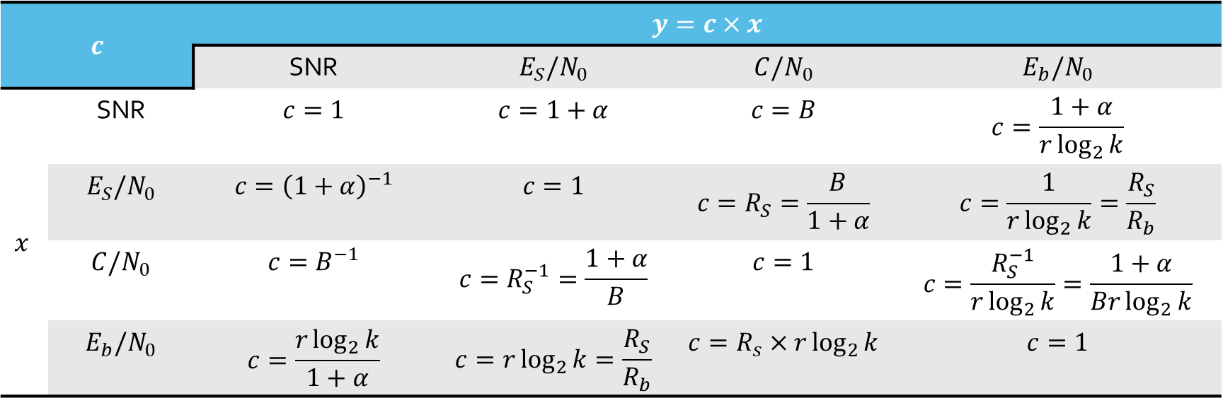

Signal to Noise Ratio and Bit Error Rate
Therefore,
$$SNR=\frac{C}{N}=\frac{P_{S}}{P_{N}}=\frac{E_{S}R_{S}}{N_{0}B}=\frac{1}{B}×\frac{C}{N_{0}}=\frac{E_{S}}{\left(1+α\right)N_{0}}=\frac{E_{b}R_{b}}{\left(1+α\right)N_{0}R_{S}}=\frac{r\log_{2}{k }}{\left(1+α\right)}\frac{E_{b}}{N_{0}}$$
Common Measures of Signal Quality and a Table of Conversion Among Them
$$c$$ |  | $$y=c×x$$
 |  | SNR | $$E_{S}/N_{0}$$ | $$C/N_{0}$$ | $$E_{b}/N_{0}$$
$$x$$ | SNR | $$c=1$$ | $$c=1+α$$ | $$c=B$$ | $$c=\frac{1+α}{r\log_{2}{k}}$$
 | $$E_{S}/N_{0}$$ | $$c={\left(1+α\right)}^{−1}$$ | $$c=1$$ | $$c=R_{S}=\frac{B}{1+α}$$ | $$c=\frac{1}{r\log_{2}{k}}=\frac{R_{S}}{R_{b}}$$
 | $$C/N_{0}$$ | $$c=B^{−1}$$ | $$c=R_{S}^{−1}=\frac{1+α}{B}$$ | $$c=1$$ | $$c=\frac{R_{S}^{−1}}{r\log_{2}{k}}=\frac{1+α}{Br\log_{2}{k}}$$
 | $$E_{b}/N_{0}$$ | $$c=\frac{r\log_{2}{k}}{1+α}$$ | $$c=r\log_{2}{k}=\frac{R_{S}}{R_{b}}$$ | $$c=R_{s}×r\log_{2}{k}$$ | $$c=1$$

Slide 25
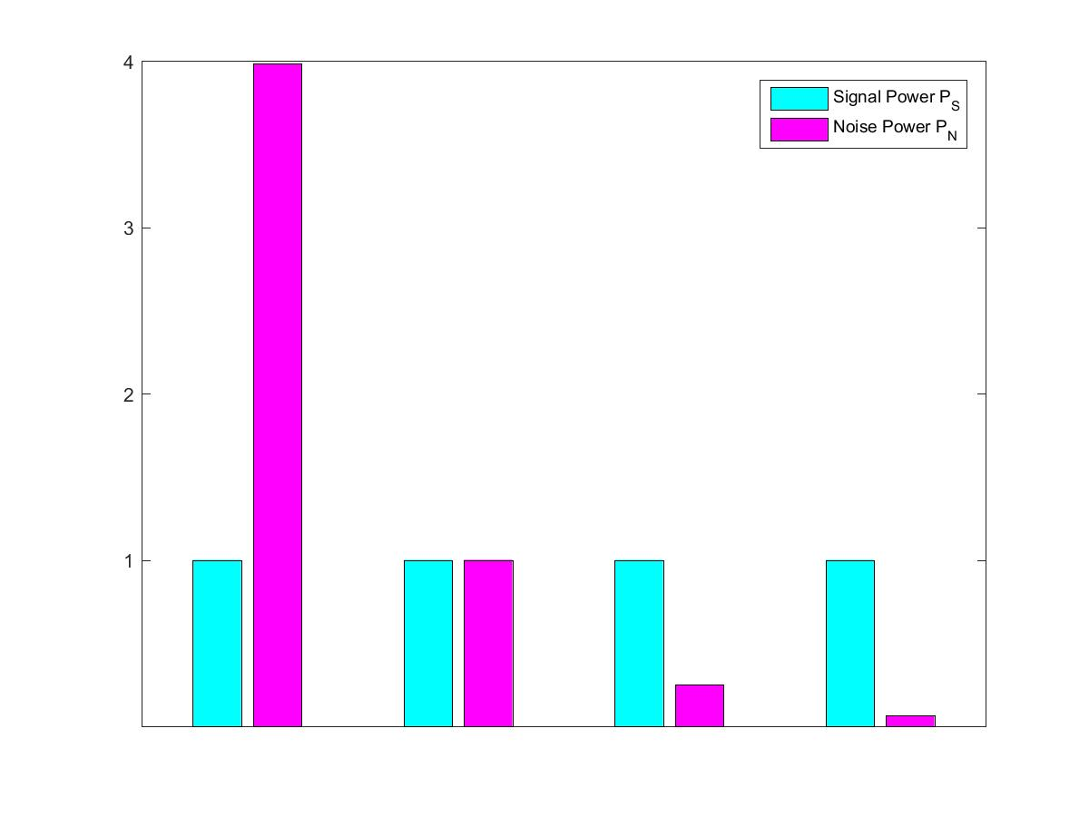
SNR in Linear and Logarithmic Scale
SNR is often expressed in logarithmic (decibel) scale
This chart shows the relative levels in the regular (linear) scale for different SNR values in dB
Blue: Signal Power Level $P_{S}$
Pink: Noise Power Level $P_{N}$
SNR = -6 dB
SNR = 0 dB
SNR = +6 dB
SNR = +12 dB

Slide 26
Spectral Efficiency
Spectral efficiency is a key metric that denotes whether the available bandwidth is utilized efficiently for data transport
Defined as the ratio of bit rate to bandwidth: $\frac{R_{b}}{B}≤\frac{C}{B}=\log_{2}\left(1+\frac{P_{S}}{P_{N}}\right)$ in bps/Hz
Higher value → many bits are getting transported for each Hertz of bandwidth
Possible when a lot of power is available
Low value → only a few bits are transported for each Hz of bandwidth
Possible when a lot of bandwidth is available
Can alternatively be also defined as
A function of $E_{S}/N_{0}$: $\frac{R_{b}}{B}≤\frac{C}{B}=\log_{2}\left(1+\frac{E_{S}}{N_{0}}\right)$ in bps/Hz
A function of $E_{b}/N_{0}$: $\frac{R_{b}}{B}≤\frac{C}{B}=\log_{2}\left(1+\frac{C}{B}×\frac{E_{b}}{N_{0}}\right)$ in bps/Hz
Pulse-shaping factor $α$ taken to be zero in the above

Slide 27
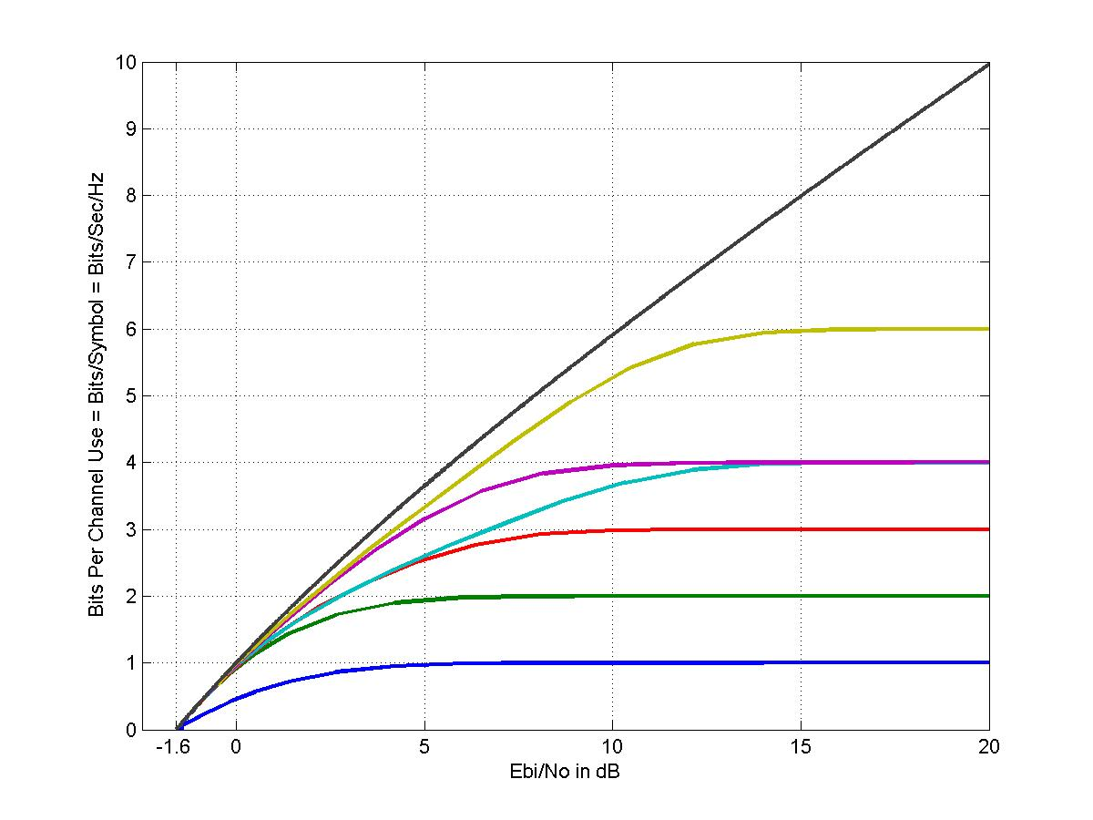
Shannon Capacity of AWGN Channel: Spectral Efficiency
Spectral efficiency in bps/Hz as a function of $E_{b}/N_{0}$:
$\frac{R_{b}}{B}≤\frac{C}{B}=\log_{2}\left(1+\frac{C}{B}×\frac{E_{b}}{N_{0}}\right)$ in bps/Hz
Spectral efficiency becomes zero when $E_{b}/N_{0}$ is -1.6 dB
Effect of noise can be completely removed by channel encoder provided $\frac{E_{b}}{N_{0}}>−1.6$ dB and a lot of bandwidth is available
Shannon capacity applies when the transmitted symbols are not constrained to lie on a pre-defined constellation
Modulation constrained capacity is smaller than the Shannon capacity and is also shown here
$C/B$ in bps/Hz
Shannon Capacity
Unattainable Region
BW Constrained Regime
64-QAM
16-APSK
Power Constrained Regime
16-PSK
8-PSK
QPSK
BPSK
$E_{b}/N_{0}$ in dB

Slide 28
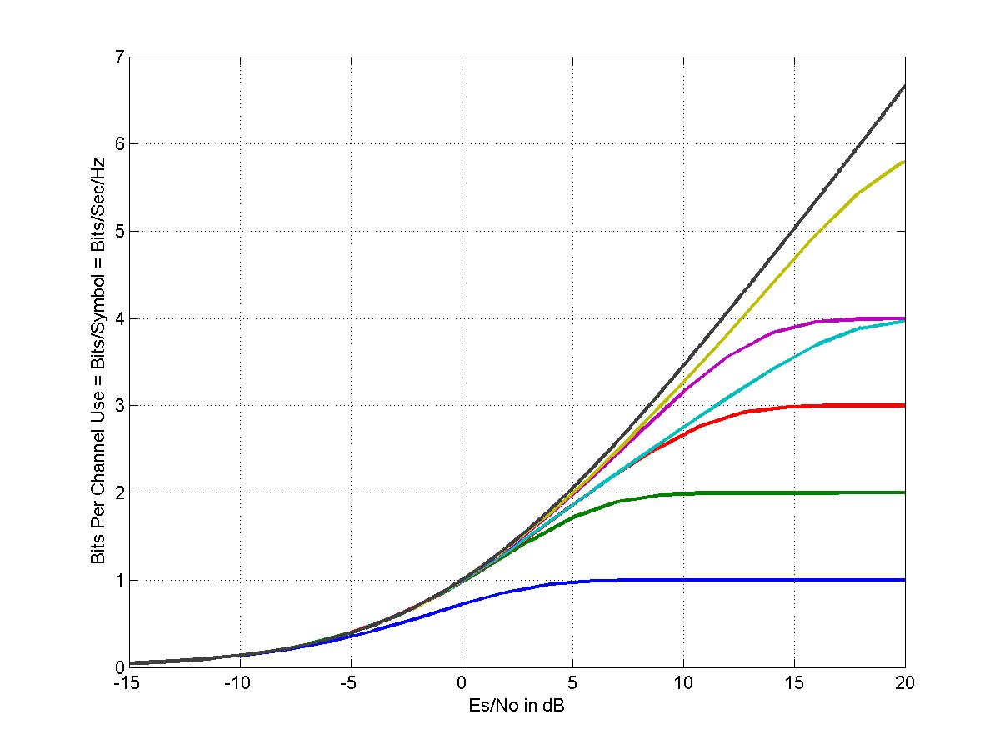
Shannon Capacity of AWGN Channel: Spectral Efficiency
Spectral efficiency in bps/Hz as a function of $E_{S}/N_{0}$:
$\frac{R_{b}}{B}≤\frac{C}{B}=\log_{2}\left(1+\frac{E_{S}}{N_{0}}\right)$ in bps/Hz
Since $\frac{E_{s}}{N_{0}}=\frac{E_{b}}{N_{0}}×\frac{C}{B},$ this result is obtained by scaling the X axis of the previous chart by the values along the Y axis
$C/B$ in bps/Hz
Shannon Capacity
64-QAM
16-APSK
16-PSK
8-PSK
QPSK
BPSK
$E_{S}/N_{0}$ in dB

Slide 29
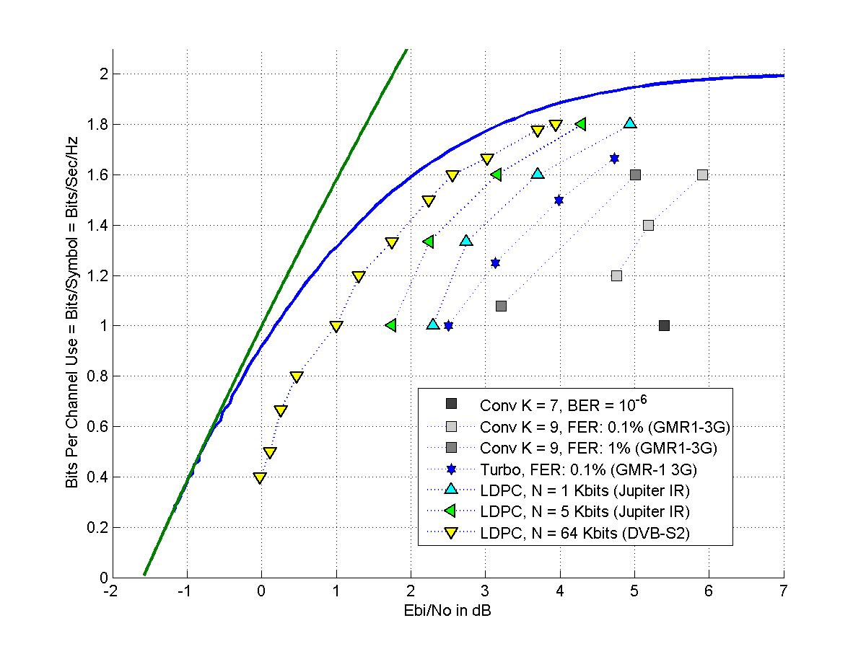
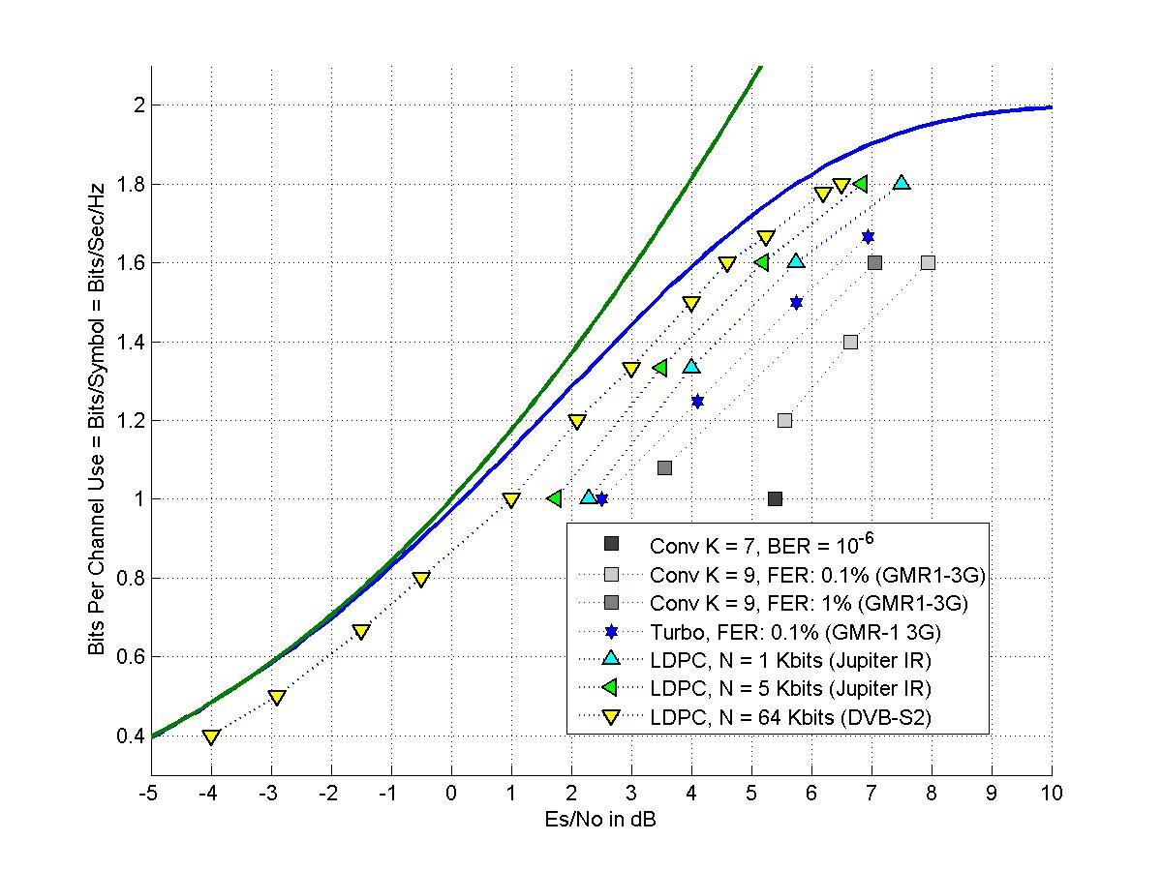
Shannon Capacity of AWGN Channel: Spectral Efficiency
Attainable performance with practical channel coding technology and QPSK modulation
As a function of $E_{b}/N_{0}$
As a function of $E_{S}/N_{0}$

Slide 30
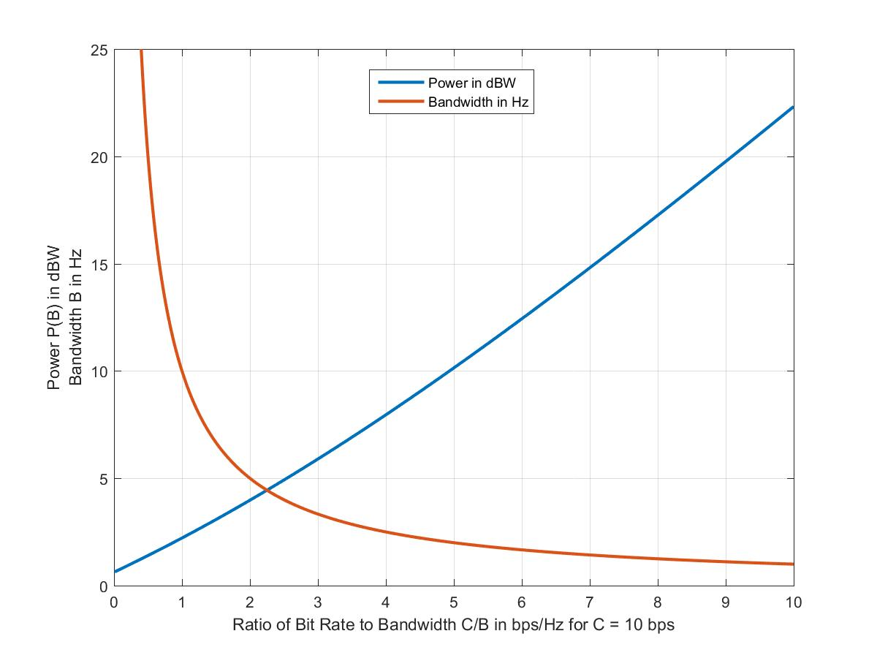
Shannon Capacity of AWGN Channel: Spectral Efficiency
In an alternate depiction of Power and Bandwidth trade-off, we consider here a scenario with a constant bit rate of $C=10$ bps
Code rate $r$ is linearly increased from $0$ to $1$
Bandwidth $B$ reduction is inversely proportional to this linear increase
Noise spectral density $N_{0}$ is set to 1/6 W/Hz
The attached plot shows the required power and the bandwidth as a function of bps/Hz

Slide 31
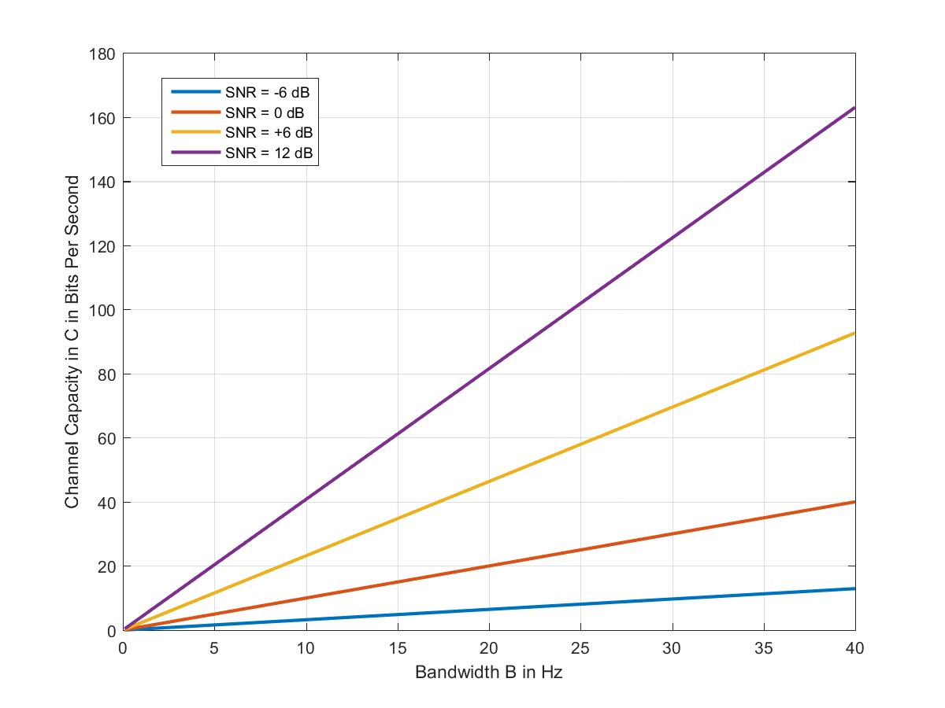
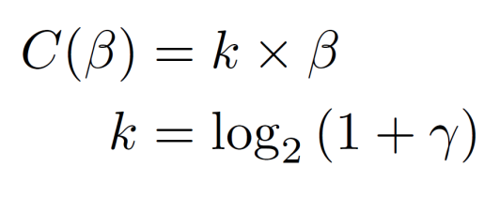
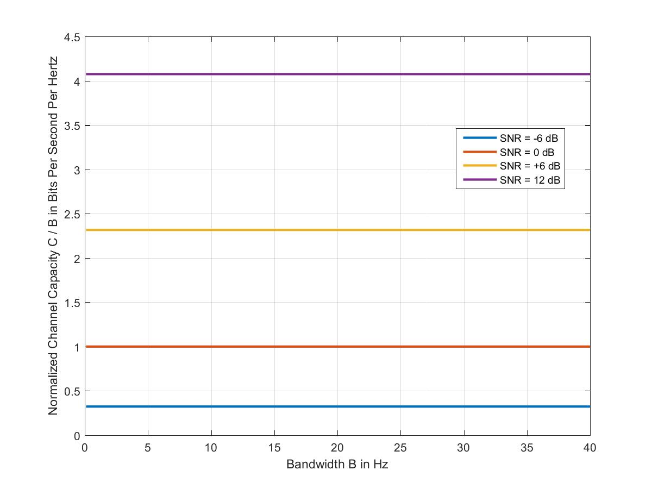
Shannon Capacity of AWGN Channel: Constant SNR Operation
Channel Capacity in bits per second
If SNR can be held constant, the channel capacity $C$ grows linearly with the bandwidth $B=β$:
For example, if $\frac{P_{S}}{P_{N}}=γ=1$,
$C=β×\log_{2}\left(1+γ\right)$
$=β×\log_{2}\left(1+1\right)=β$; i.e., $k=1$
Note: since $P_{N}=N_{0}β$, a constant $\frac{P_{S}}{P_{N}}=γ$ with increasing $β$ is possible in AWGN channel only if the signal power $P_{S}$ is increased in the same proportion as $β.$ This is often infeasible
An important efficiency measure is how well the allotted bandwidth is being utilized to deliver the data rate. This is called the spectral efficiency and it is given as the ratio of the data rate to the bandwidth and has a unit of bps/Hz
This plot shows that the spectral efficiency reduces if SNR becomes small
Normalized channel capacity in bits per second per Hertz

Slide 32
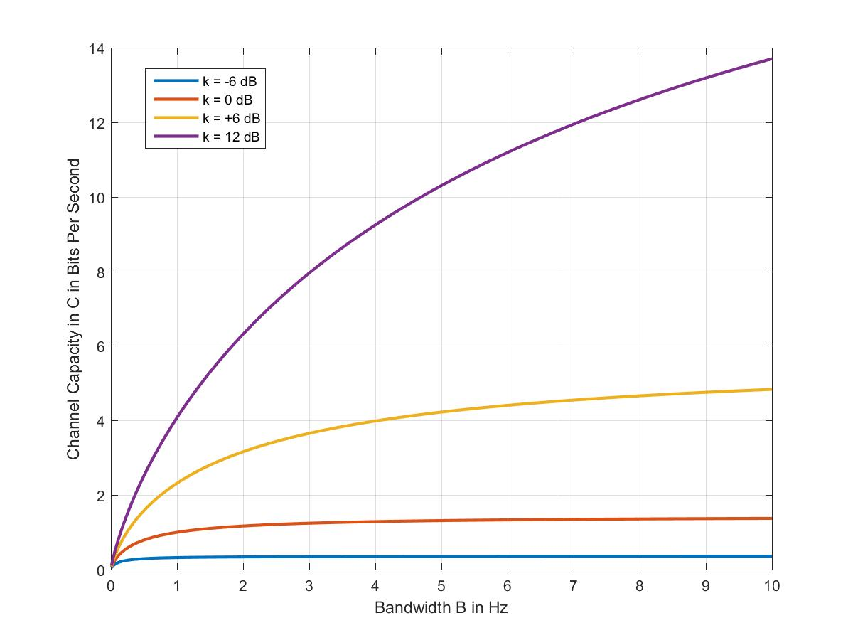
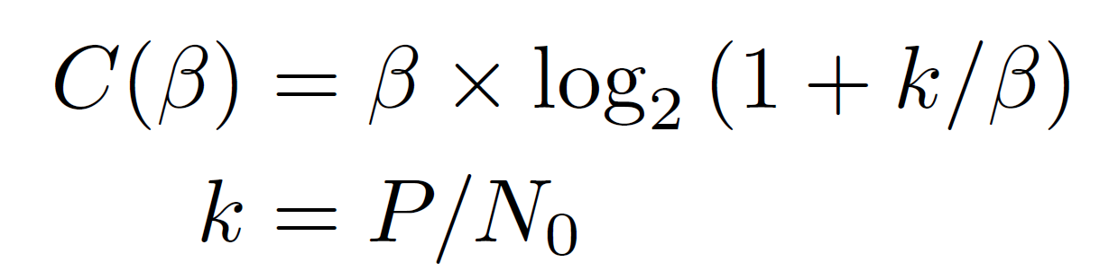
Power and Bandwidth Tradeoff: Constant Power Operation
Let us assume a power constrained operation
Transmit power $P$ is a constant
Channel capacity is given as a function of $B$ as the following nonlinear function
In this plot, this function is plotted for $k=P/N_{0}$ values of $−6$ dB, 0 dB, +6 dB, +12 dB

Slide 33
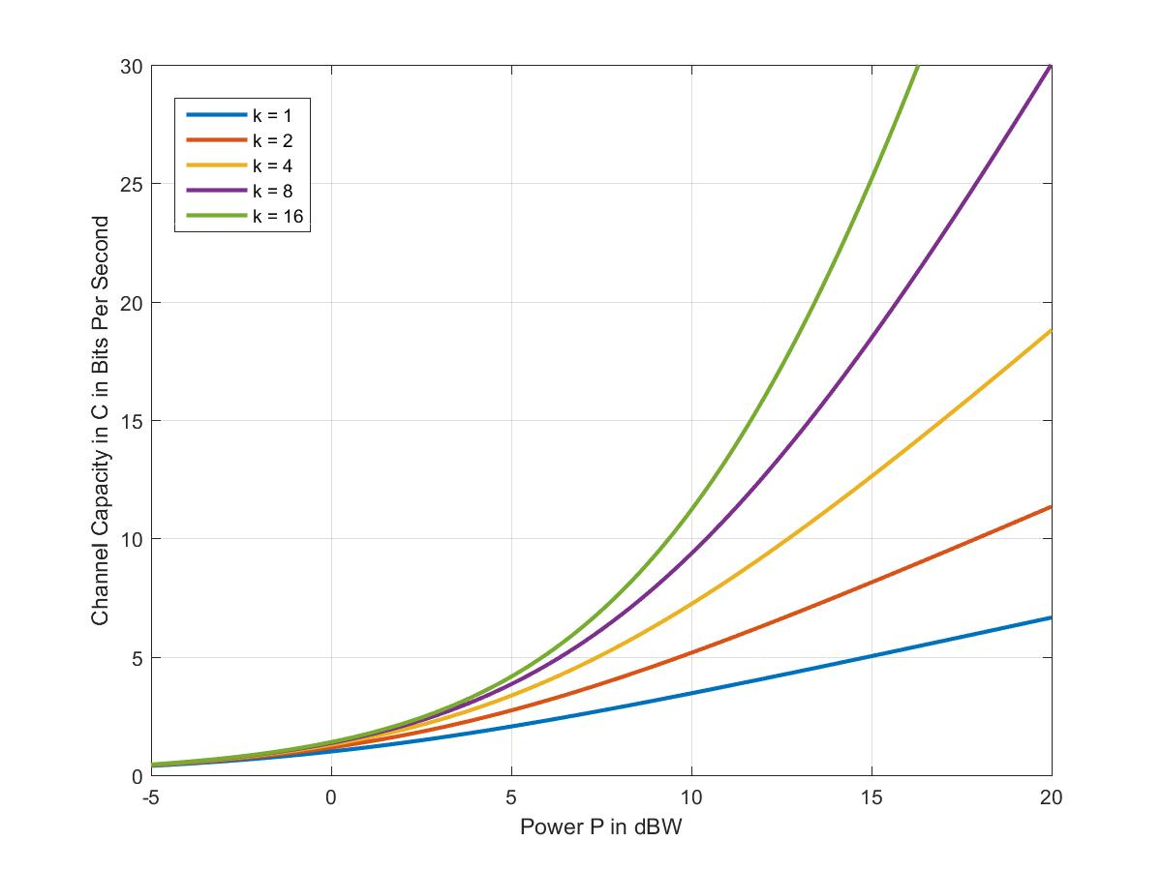
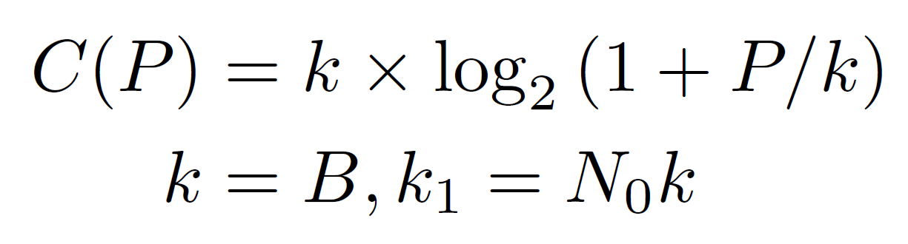
Power and Bandwidth Tradeoff: Constant Bandwidth Operation
Let us assume a bandwidth constrained operation: bandwidth $B$is a constant
Channel capacity is given as a function of $P$ as the following nonlinear function
In this plot, this function is plotted for $k=B$ values of $1, 2, 4, 8$ and $16$ Hz with $N_{0}=1$ W/Hz

Slide 34
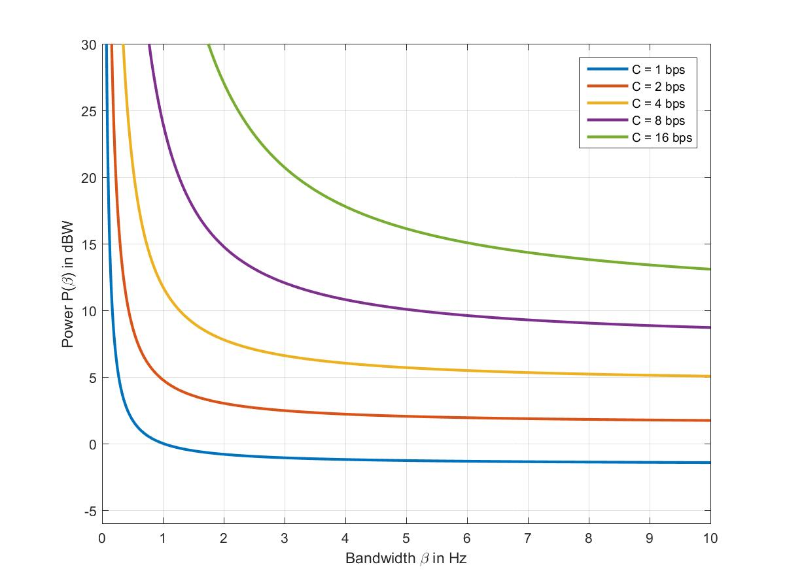
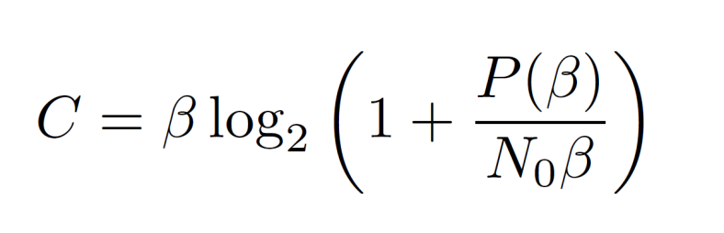

Power and Bandwidth Tradeoff: Constant Data Rate Operation
Given the bandwidth $B=β$ Hz, the following defines the power $P(β)$ as function of $β$ for a given channel capacity $C$
This function is plotted as a function of $β$ for $N_{0}=1$ Watts/Hz, and for several values of $C$

Slide 35
Spectral Efficiencies and Required Es/No for Different Modulation and Coding Schemes

Slide 36

Spectral Efficiencies and Required Es/No for Different Modulation and Coding Schemes

Slide 37

DVB-S2 versus DVB-S2X

Slide 38

DVB-S2 versus DVB-S2X

Slide 39
An Example Link Calculation
Wireless System Parameter

Slide 40


A Model of Downlink From Base Station to the Mobile Phone
$$P_{TX}$$
$$G_{TX}$$
$$P_{EIRP}$$
$$L$$
$$G_{RX}$$
$$T_{a}$$
$$NF$$
$$T_{e}$$
$$T$$
$$G_{RX}/T$$

Slide 41
An Example Link Calculation (Continued)
Wireless System Parameter

Slide 42
EIRP, Antenna Gain $G$, and Path Loss $L$
Equivalent Isotropically Radiated Power or EIRP is given as EIRP = $P_{TX}×G_{TX}$
Gain of the antenna $G$ is a function of the area (effective aperture) of the antenna and the transmission frequency
Free-space Path Loss is given as
Therefore, the ratio $G/L$ is given as
$η$: antenna efficiency, typically in the range of 0.5 to 0.7
$D_{Ant}$: antenna diameter in meters
$f:$ carrier frequency in Hertz
$c:$ speed of light in vacuum, 299792458 m / s
$d$: path distance in meters

Slide 43
Antenna Gain
Antenna gain (maximum) is given as $G=\frac{4π}{λ^{2}}×A_{eff}$
Effective aperture (area) of an antenna with circular aperture of diameter $D_{Ant}$ is $A_{eff}=\frac{πD_{Ant}^{2}}{4}$
Therefore, the max gain is given as $G={\left(\frac{πD_{Ant}^{}}{λ}\right)}^{2}$
Overall efficiency $η$ of the antenna is determined by several factors:
Uniform versus tapered illumination
Amount of energy radiated by the primary source that is captured by the reflector
Difference between the ideal parabolic shape of the antenna versus the actual mechanical shape
Losses due to ohmic and impedance mismatch

Slide 44
Transmit Antenna Gain Calculation
Color legend: green refers to input, red refers to output, yellow is a constant

Slide 45
Evaluation of SNR
We have seen that the SNR = $\frac{P_{S}}{P_{N}}=\frac{C}{N}$ is a critical parameter that determines the BER and the achievable data rate
We have also seen earlier that $P_{N}=N_{0}B$
Here $N_{0}$ is the power spectral density
When the source of the noise is thermal
agitations of the electrons in the transceiver circuitry, the noise power spectral density $N_{0}$ is given
as $k×T$
Here, $k$ is Boltzmann’s Constant with a value of 1.38064852 × 10⁻²³ m² kg s⁻² K⁻¹
$T$ is the system noise temperature in deg K
Power Spectral Density $N_{0}$
Ideal (Brickwall) Filter with Bandwidth $B$
Filter Bandwidth B

Slide 46
Noise Figure
Signal with Power $P_{S}$
$$G$$
Noise with Power $P_{N}$
A device $D$ with a gain of $G$
Consider an additive noise model, where the noise is added to the
signal before the sum is fed to a device $D$ (e.g., an amplifier) with a gain of $G$
If the device $D$ is ideal, it won’t introduce any additional noise: SNR at input = $\frac{P_{S}}{P_{N}}$ equals SNR at the output of the device which is $\frac{G×P_{S}}{G×P_{N}}=\frac{P_{S}}{P_{N}}$
Actual devices add some extra noise with power $P_{N,D}$ such that the SNR at the output is $\frac{G×P_{S}}{P_{N,D}+G×P_{N}}$
Ratio of the Input SNR to the Output SNR is called the Noise Factor $F$: $\frac{P_{N,D}+G×P_{N}}{G×P_{N}}$
This ratio depends on three terms: device noise power $P_{N,D}$, device gain $G$ and input noise power $P_{N}$.
For a given device, the first two terms are fixed. Input noise power $P_{N}$ is fixed, by convention, to $kT_{0}B$, where $T_{0}=273$ degK (which is the typical room temperature of ${16.8}^{o}c$)
Noise Figure NF = $10×\log_{10}{F}$ dB

Slide 47
Effective Noise Temperature
Effective noise temperature of the device is called $T_{e}=\frac{P_{N,D}}{kGB}$
It can be shown that $T_{e}=T_{0}\left(F−1\right)$
Total noise temperature at the output of the device is called the system noise temperature
$$T_{SYS}=T_{in}+T_{e}$$
where $T_{in}$ is the noise temperature at the device input. This can be different from $T_{0}={273}^{o}K$
If there are two devices $D_{1}$ and $D_{2}$ in cascade with noise factors of $F_{1}$ and $F_{2}$, effective noise temperatures of $T_{e1}$ and $T_{e2}$ and gains of $G_{1}$ and $G_{2}$, the cascaded system’s overall noise factor and overall effective temperature are given as follows:
$F=F_{1}+\frac{F_{2}−1}{G_{1}}$, and
$T_{e}=T_{e1}+\frac{T_{e2}}{G_{1}}$

Slide 48
Receiver Antenna Gain and Figure of Merit Calculation Worksheet

Slide 49
Link Equation (linear scale)
Definition of $\frac{C}{N_{0}}$
Received power $P_{RX}=G_{RX}×RIP$
Received noise power $N_{0}=kT$
$RIP=\frac{P_{EIRP}}{L}$
$P_{EIRP}=P_{TX}×G_{TX}$; $T=T_{a}+T_{e}$
$T_{e}=T_{0}(F−1)$

Slide 50
Link Equation (decibel scale)
Link equation in dB scale: multiplications and divisions turn into additions and subtractions
All the values are in dB, including Receiver Figure of Merit ($G_{RX}/T)$ which is a ratio that is evaluated in linear scale (using Noise Figure, $T_{e}$ and $T_{a}$) and converted in dB

Slide 51
Antenna Beamwidth
Beamwidth of the antenna (3 dB) can be approximated as $κ×\frac{c}{f×D}$ , where$κ$ is a constant that depends on the antenna shape. For parabolic antenna, $κ$ is usually taken as ${70}^{o}$
See
http://www.phys.hawaii.edu/~anita/new/papers/militaryHandbook/antennas.pdf
https://en.wikipedia.org/wiki/Parabolic_antenna

Slide 52
Power Flux Density and Path Loss
For an isotropic antenna, the portion of transmit power $P_{TX}$ radiated per unit solid angle is given as $\frac{P_{T}}{4π}$
For an actual antenna with a gain of $G_{TX}$, the power per unit angle is $\frac{P_{T}G_{T}}{4π}$
A receiving antenna with an aperture of $A_{RX}$ at a distance of $d$ from the transmit antenna subtends a solid angle of $A_{RX}/d^{2}$ at the transmitter
Thus, it receives a power of$\frac{P_{T}G_{T}}{4πd^{2}}×A_{R}=\frac{P_{T}G_{T}}{4πd^{2}}×\frac{G_{R}}{\frac{4π}{λ^{2}}}$
Ratio $\frac{P_{T}G_{T}}{4πd^{2}}$ is called the power flux density $Φ$ in Watts/$m^{2}$
Ratio ${\left(\frac{4πd}{λ}\right)}^{2}$ is called the path loss and it is the ratio of the received to transmit powers for isotripic antennas at the transmitter and the receiver
Additional losses: atmospheric losses, depointing losses, tx/rx hardware losses, and polarization mismatch losses (see section 5.4.4)

Slide 53
A Technological Roadmap by Facebook
https://fbcdn-dragon-a.akamaihd.net/hphotos-ak-ash3/t39.2365-6/851574_611544752265540_1262758947_n.pdf

Slide 54


Factors that Increase the Noise Floor
There are multiple sources of interference in addition to the AWGN
These all impairments add together in the received signal. How to account for this?
A theorem from statistics:
If $N$ different random variables $x_{n}$, where $n^{th}$ variable has a variance of $σ_{n}^{2}$, are added, the sum $\sum_{n=1}^{N}{x_{n}}$ has a variance of $\sum_{n=1}^{N}{σ_{n}^{2}}$ provided the individual random variables $x_{n}$ are uncorrelated
Apply the above theorem to answer the earlier question:

Slide 55



Factors that Increase the Noise Floor
A care needs to be taken before performing the addition on the prior slide
Cannot add two noise powers if they are not normalized with respect to each other
$γ=\frac{P_{S}}{P_{N}}=\frac{G×P_{S}}{G×P_{N}}$. Thus, one obtains the same ratio for SNR for widely different noise powers.
Add the noise power after it is normalized by the signal power
Alternatively,

Slide 56
Data Rate (Throughput) Adaptation and Power Control
wireless systems support multiple data rates
Optimal data rate is selected by a dynamic throughput adaptation scheme
Dynamic Throughput Adaptation maximizes throughput for a given channel condition
Adapts the data rate to match with the varying channel condition
The system additionally performs power control
Combination of throughput adaptation and power control is referred to as the link control/adaptation mechanism

Slide 57




Concept and Benefit of Data Rate (Throughput) Adaptation
Throughput Adaptation ensures that the achieved throughput is maximized given an operating link condition
Without the throughput adaptation, the data throughput remains a constant above a C/No threshold, and approaching zero below the threshold
Achieved throughput stays on the envelope of the family of Signal Quality (Es/No) → Throughput curves
With throughput adaptation, as the link condition improves and the received C/No increases, the achieved throughput increases as well
Data Rate, in Mbps
If the link condition degrades, the throughput gradually reduces instead of falling off a cliff
Use Slide Show mode to enable the Animation Effect
C/No in dB →

Slide 58



Dynamic Throughput Adaptation and Power Control
An example of dynamic throughput adaptation and power control
Simulated link gain:
Link has a low gain at the beginning, improves to max gain half way, and reverts back to low gain
dB
Channel Gain
Achieved throughput:
Dynamic link adaptation ensures the attained throughput is the best achievable given the current link condition
Data Rate
Achieved Throughput
Transmitted Power:
Power control loop ensures that the transmitted EIRP (a) stays below the max EIRP limit, and (b) is the minimum required given the current link condition
dBW
Transmitted Power
Time →

Slide 59
A Schematic of Throughput Adaptation Algorithm
UT
SAT
SAT Gateway
[Code Rate] Change Command
Wireless Link
Base Station
Throughput Adaptation Algorithm
Inroute Transmitter
Inroute Receiver
Transmit Power Command
ULPC
Signal Processing Algorithm
Inroute
Signal Quality Feedback
Target Inroute Signal Quality
Inroute
Signal Quality Feedback
Outroute Receiver
Outroute Transmitter

Slide 60

Large Scale and Small Scale Path Loss Models
Ideal path loss model is , however, the actual attenuation exhibits large scale and small scale variations
Free Space Path Loss
Distance $10×\log_{10}{d}$ between transmitter and receiver

Slide 61





An Intuitive Explanation of Fading
Two reflected waves reach the eye; one from the inner boundary and another from the outer boundary of the soapy layer of thickness $t$
Due to this process, some specific frequencies of the white light get cancelled or highly attenuated. Colors corresponding to these frequencies are suppressed and the remaining colors (since they do not add up to make white color) cause the observed colorful pattern
A colorful pattern in a soapy bubble
Depending on the wavelength of the radiation and the depth $t$ of the soap bubble, these two waves (2) and (5) may reach the eye ${180}^{o}$ out of phase, thereby cancelling each other

Slide 62

An Intuitive Explanation of Fading
RF radiation in Wireless Communications systems undergoes the same type of (mostly) destructive and (sometimes) constructive interference since the radio wave arrives at the receiver after multiple reflections and through multiple paths or multipaths
Furthermore, the lengths of multipaths may be changing, and therefore, the pattern of interference is not static
Typical Wireless Communications Systems

Slide 63

Frequency Division Multiple Access
Usually the available spectrum on uplink or downlink “divided” into many channels, where each channel is assigned to a particular user terminal (UT) or a group of UTs
These frequency channels are orthogonal; i.e., UT transmission on a given frequency channel does not typically interfere with the transmissions on the other frequency channels
This technique of multiplexing several users over a given spectrum is called Frequency Division Multiple Access (FDMA).
Other common techniques are Time Division Multiple Access (TDMA) and Code Division Multiple Access (CDMA)
FDMA
TDMA
CDMA
http://www.itu.int/osg/spu/ni/3G/technology/

Slide 64


Cellular Concept
Clusters and Cells in a 7-Cell Frequency Reuse Scheme
A common technique is to reuse the available spectrum by dividing the target coverage area on the ground into multiple clusters.
Entire spectrum is allocated in each of the clusters that are formed
Reusing the same spectrum (i.e., assigning the same band of frequencies to multiple users that are active simultaneously) would create unacceptable amount of interference
To avoid this, each cluster is further subdivided into cells, and only a portion of the spectrum is assigned to a cell
Cell $k$ ($k=1,…,K$, where $K$ is the number of cells/cluster) signals of a given cluster interfere with Cell $k$ signals of all the other clusters since they share the same channel (or band of frequencies ).
Resulting co-channel interference (CCI) can be reduced by increasing $K$
https://www.cse.iitb.ac.in/~satyajit_01/seminar/node5.html

Slide 65

Frequency Reuse of 4

Slide 66


Slide 67


Slide 68

Frequency Reuse and System Capacity
Following is a comparison of the benefit of frequency reuse on system capacity
Thus, the larger the number $N$ of clusters, the greater the multiplicative increase in the system capacity
However, as $N$ is increased over a given service region, the frequency reuse factor $K$ has to be reduced. This leads to an increased CCI as shown next

Slide 69


An Implication of Frequency Reuse: Co-Channel Interference or CCI
CCI can be evaluated for the wireless systems in the following manner:
${\left(\frac{C}{I}\right)}_{CCI}=$ Carrier Power to Interference Power
Carrier power $C=P_{RX}$ is the power received of the desired user’s signal
Interference power $I=I_{0}B$ is the power received over the bandwidth $B$ of all the cochannel transmissions
Evaluation of I:
On the downlink: power received at the desired user’s location from the sidelobes of all cochannel transmit beams
On the uplink: power received in the return uplink beam of the desired user from the locations of all the cochannel cells

Slide 70

An Implication of Frequency Reuse: Co-Channel Interference (CCI)
CCI can be evaluated for the wireless systems in the following manner:
${\left(\frac{C}{I}\right)}_{CCI}=$ Carrier Power to Interference Power
Carrier power $C=P_{RX}$ is the power received of the desired user’s signal
Interference power $I=I_{0}B$ is the power received over the bandwidth $B$ of all the cochannel transmissions
Realization of the Co-channel Interference Power I on the uplink is different compared to its realization on the downlink
On the downlink: CCI power equals the power received at the desired user’s location from the sidelobes of different cochannel transmit beams
On the uplink: CCI power equals the power received in return uplink beam of the desired user from the locations of all the cochannel cells
CCI, in general, increases (i.e., ${\left(\frac{C}{I}\right)}_{CCI}$ reduces) as the frequency reuse factor $K$ is reduced. This is shown in the next two slides

